Slide 1
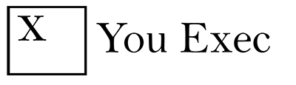
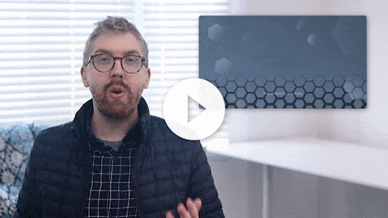
You Exec provides business resources that move your career forward. Access our full library of presentations, spreadsheet models, and business book summaries. We do the work, you take the credit.
Errors & Omissions Liability (E&O): You Exec makes no guarantee that the statements, analysis, projections, estimates, graphs, reports, numbers, and any derivatives sourced from this presentation are free of errors and omissions. You Exec assumes no liability for erroneous outcomes derived from this presentation.
Watch explainer
For a commercial or group license, please visit Unlimited and schedule a demo.
This video will walk you through the benefits of this framework. Paid members, please log in for a better viewing experience.

Slide 2

CUSTOMER ACQUISITION TOOLBOX
Presented by You Exec

Slide 3
CUSTOMER ACQUISITION COST 1/2
Input Variables
Flow | Quantity | Conversion %
Total Paid Web Visitors | 10,000
Trails | 500 | 5%
Customers | 50 | 10%
SEM Marketing Spend | $5,000
Total Headcount Costs | $49,500
Total Web Visitors | 10,000
SEM Cost Per Click | $0.50
Conversion To Trail % | 5%
Trail Conversion % | 10%
No Of Sales & Marketing Staff | 3
Cost Per Employee Per Month | $16,500
Cost of Customer Acquisition
Without Headcount Costs | $10,000
With Headcount Costs | $1,090.00

Slide 4
CUSTOMER ACQUISITION COST 2/2
For a Direct Salesforce
Sales
Team Composition | 1
On Target Earnings | $ 230,00
Salary Cost | $ 230,00
Salary + Overhead | $ 310,00
Total Team Cost | $ 560,00
Avg. Team Failure Rate | 25%
Adjusted Team Cost | $ 747,00
No. Of Marketing People | 0.5
Average Cost Per Person | $ 200,00
Marketing Program Spend | $ 150,00
Total Marketing Costs | $ 350,00
Total Sales & Marketing Spend | $ 1,097,000
No. Of Deal Per Team Per Year | 10
Cost Of Customer Acquisition | $ 109,700

Slide 5
LTV TO CAC RATIO
An ideal LTV:CAC ratio should be 3:1. The value of a customer should be three times more than the cost of acquiring them.
1:1 = spending too much.
5:1 = spending too little.
Target: 3.0
Ratio
0
(Spend Less)
5
(Spend More)
2.9
Actual

Slide 6
CAC SEGMENTING

Slide 7
COHORT ANALYSIS
 | % of customers retained by month
Total Customers | Jan | Feb | Mar | Apr | May | Jun | Jul
37 | 100% | 95% | 95% | 84% | 81% | 62% | 59%
39 |  | 100% | 97% | 82% | 74% | 67% | 54%
23 |  |  | 100% | 91% | 87% | 74% | 70%
34 |  |  |  | 100% | 100% | 94% | 88%
43 |  |  |  |  | 100% | 98% | 81%
63 |  |  |  |  |  | 100% | 98%
53 |  |  |  |  |  |  | 100%
CAC
$13
Channel: Facebook Ads
Location: United Kingdom
Age Group: 25-30
Frequency: 3

Slide 8
PAYBACK ANALYSIS
Q2-18
Q3-18
Q4-18
Q1-19
Q2-19
Q3-19
Q4-19
 | ACTUAL |  |  |  |  | GOAL
MRR (new customers) | $ 79 | $ 80 | $ 81 | $ 83 | $ 85 | $ 88 | $92
Cost to Acquire (one-time) | $ 610 | $ 600 | $ 580 | $ 575 | $ 570 | $ 550 | $530
Cost to Launch (one-time) | $305 | $300 | $ 290 | $ 285 | $ 285 | $ 275 | $265
Cost to Support (monthly) | $ 25 | $ 24 | $ 24 | $ 23 | $ 23 | $ 22 | $21
PAYBACK IN MONTHS: (cAcquire+cLaunch)/(MRR-cSupport) | 16.9 | 16.1 | 15.3 | 14.3 | 13.8 | 12.5 | 11.2
QoQ change
MRR (new customers) |  | 1.3% | 1.3% | 2.5% | 2.4% | 3.5% | 4.5$
Cost to Acquire (one-time) |  | -1.6% | -3.3% | -0.9% | -0.9% | -3.5% | -3.6$
Cost to Launch (one-time) |  | -1.6% | -3.3% | -1.7% | 0.0% | -3.5% | -3.6$
Cost to Support (monthly) |  | -4.0% | 0.0% | -4.2% | 0.0% | -4.3% | -4.5$

Slide 9
FUNNEL ANALYSIS
Stage 1
Stage 2
Stage 3
Stage 4
Stage 5
Lead ($0)
Contacted ($0)
Interested ($0)
Tried Demo ($0)
Customer ($15300)
LEAD
276
CONTACTED
276
INTERESTED
156
TRIED DEMO
98
CUSTOMER
51
❑ 23.2% (64)
Dropoff
❑ 26.4% (56)
Dropoff
❑ 37.2% (58)
Dropoff
❑ 48.0% (47)
Dropoff
18.48% (51)
Conversion

Slide 10
Total Market
15 Million
CUSTOMER SEGMENTATION
MARKET SIZING
Unaware
1.75 Million
Target Market
3.25 Million
Not Tried
1.35 Million
Tried
1.9 Million
Negative Opinion
0.35 Million
Neutral
0.65 Million
Favorable Opinion
0.35 Million
Rejected
0.15 Million
Not Yet Repeated
0.75 Million
Repeated
0.75 Million
Loyal To Other Brand
0.10 Million
Switcher
0.15 Million
Loyal Brand
0.75 Million
Light User
0.05 Million
Regulate User
0.15 Million
Heavy User
0.55 Million

Slide 11
PVP INDEX
Rate your market segments on a Scale of 1 to 10 based on The PVP index.
P
V
P
Personal Fulfillment
How much do you enjoy dealing with this type of customer?
Value
How much does this market segment value your work?
Profitability
How profitable is the work you do?
TOTAL
Current
10
6
6
22
Goal for Quarter
10
9
9
29

Slide 12
TARGET PROSPECTS DASHBOARD
DEVICE USAGE
TARGET AGE GROUP
Mobile
90%
Tablets
70%
25%
45-60 Years
90%
Laptop
Desktop
90%
75%
30-45 Years
50%
50%
$60K
60%
90%
Minimum Income
Married Couples
White-collar workers

Slide 13



LEAD SCORING
PROSPECTS
Returning Visitor
Time on Site is More than 5 Min
Country is USA
Score
Age: 25-35 Gender: Male
Age: 30-40 Gender: Female
Age: 35-45 Gender: Male

Slide 14
CUSTOMER SEGMENTATION BY REGION
60%
$68M
NORTH AMERICA
Expected to grow at rate 17.1% from 2021
$60M
EUROPE
It keep pace with global trends
30%
$65M
ASIA
Poll, 71,568 consumers across 12 markets
85%
$78M
AFRICA
Projected to rise to $2.1 trillion by 2025
75%

Slide 15
NEW CUSTOMER BY SOURCE
75
35
80
55
50
65
40
EVENT
SEO
DIRECT MAIL
WEBSITE
EMAIL
SOCIAL
ADVERTISING

Slide 16

CUSTOMER METRICS
CMRR Per Customer
$6,807
This year to date
+$755 vs. prior year
CMRR
$1,170K
This year to date
+$755 vs. prior year
CAC
$2,093K
This year to date
+200,830vs. prior year
Payback in Months
3.3
This year to date
-4 from prior year
Customer Churn
2.50%
This year to date
Revenue Churn
2.96%
This year to date
+$755 vs. prior year
Customer Renewal
97.50%
This year to date
Revenue Renewal
98.19%
This year to date
Returning Visitor
New Customers

Slide 17
Funnel
Pay-per-click Campaign Optimization
Avg. Daily Impressions
1.30M
Growth 131.4%
Click-Through Rate
0.37%
Growth 0.2%
Cost Per Click
$1.79
Growth $3.51
GA Conversion Rate
1.79%
Growth -63.3%
Lead To Opps Conversion
2.15%
Growth -5.5%
Cost Per Conversion
$99.65
Growth $71.79
Leads Converted Vs. Cost Trend
Top Campaigns

Slide 18
WEBSITE
MRR
SIGNUPS PAST 4 WEEKS BY…
NET MRR CHURN RATE
POSITION
SIZE
INDUSTRY
Marketing Comms
300
1-10 Employees
300
Education
300
Product Management
280
11-25 Employees
300
Other
300
Leadership
300
26-50 Employees
300
Software
300
Engineering
300
51-200 Employees
300
IT
300
NEW BUSINESS MRR
1000
Customers
$100K
MRR
500
Quality Leads
$150
ARPA

Slide 19
Customer Lifetime Value (CLTV)
$21,420
This Improved by 29.7% from $16,518 last quarter
Customer Acquisition Cost (CAC)
$701
This dropped by 809.4% from $77 last quarter
Return on Ad Spend (ROAS)
$21,420
This Improved by 29.7% from $16,518 last quarter
Upper Trend
Upper Trend
Upper Trend
Lower Trend
Lower Trend
Lower Trend

Slide 20
CUSTOMER ACQUISITION

Slide 21
GOAL
REVENUE
SPEND
ORDERS
CUSTOMERS
CONVERSIONS
$22M
115%
$3.9M
108%
170K
101%
106K
98%
123K
98%
CUSTOMER ACQUISITION COST
CUSTOMER LIFETIME VALUE
Overview
Q4 finished strong in terms of sales and Orders, with Revenue at 115% of goal
CAC:LTV ratio is a healthy 3.2
AVERAGE ORDER VALUE
% NEW CUSTOMERS

Slide 22
New
User
Conversion Rate
Participation Rate
40%
75%
New
Visitor
VIRAL GROWTH LOOP
Invite Friends
0.75 x 7 x 0.5 x 0.4 = 1.05
Viral Coefficient
50%
Receive Invites
7
Clickthrough Rate
Branching Rate

Slide 23
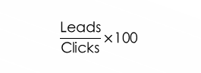
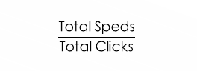
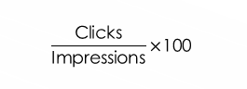
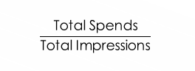
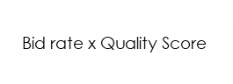
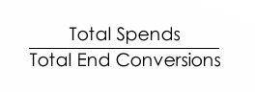
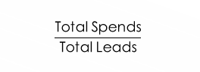
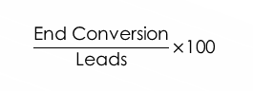
CATEGORIES & METRICS
STAGE
COST
PERFORMANCE
$$\frac{\text{Total} \text{Spends}}{\text{Total} \text{Impressions}}$$
Ad Rank/ Viewability =
$$\text{B}\text{id} \text{rate} \text{x} \text{Quality} \text{Score}$$
Top of the Funnel
IMPRESSIONS
Bid Rate/CPM =
$$\frac{\text{Total} \text{Speds}}{\text{Total} \text{Clicks}}$$
$$\frac{\text{Clicks}}{\text{Impressions}}\text{×}\text{100}$$
CLICKS
CPC =
CTR =
$$\frac{\text{Total} \text{Spends}}{\text{Total} \text{Leads}}$$
$$\frac{\text{Leads}}{\text{Clicks}}\text{×}\text{100}$$
Middle of the Funnel
LEADS
CPL =
CTL =
$$\frac{\text{Total} \text{Spends}}{\text{Total} \text{End} \text{Conversions}}$$
$$\frac{\text{End} \text{Conversion}}{\text{Leads}}\text{×}\text{100}$$
Bottom of the Funnel
CONVERSIONS
CPA =
LTB =

Slide 24
CUSTOMER ACQUISITION FRAMEWORK
SALES FUNNEL
CUSTOMER LIFECYCLE
Leads (Inbound/Outbound)
Visitors
MARKETING TEAM
Marketing Qualified Lead (mql)
Prospect
Sales qualified Lead (sql)
SALES TEAM
Opportunity
Activated User
Proof Of Concept (POP)
Closed
Customer
CUSTOMER SUCCESS TEAM
Onboarding
Activated Customer
Renew/Upsell
Loyal Customer

Slide 25
CUSTOMER ACQUISITION FRAMEWORK
The Customer Acquisition Rep is responsible for acquiring new customers through outbound and inbound inquiries. This position is responsible for reaching out to potential customers delivering a sales presentation with passion, commitment, courtesy and professionalism.
Social Media
Digital Advertising
SEO Techniques
Digital Contents
Blog Posts
Webinars, FAQs
Online Store
Product Pages
Demos
Training Materials
Online Communities
Brand Pages
DIGITAL MARKETING STRATEGIES
CUSTOMER LIFECYCLE
Visitor
Lead
Secured
Customer
Active User
Loyal Customer
SALES FUNNEL
Awareness
Education
Conversion
Engagement
Closing The Deal
Continued Engagement

Slide 26
CUSTOMER ACQUISITION PROCESS
Email Campaign
No Response
Cold Lead
4000
Positive Response
Send Email Again
SEO
Follow Up Process
Call Center
No Response
Analytics
CLIENTS VISIT
WEB-PRESENCE
LEAD
1000
3000 New Customer Acquired
Blog Posts
CRM
Positive Response
Social Networks
Social News
Option 1
No Response
Add Option
Customer Relationship Management
Positive Response
Hot Lead
5000
Send Email Again
No Response
Follow Up Process
Option 2
Positive Response

Slide 27
P.O.E.M. MEDIA MODEL
 | Paid Media Outbound Campaigns | Earned Media Inbound Marketing | Owned Media Nurture, Retention, Advocacy
Core Elements & Drivers | Money = Traffic, No money, No traffic Channels are optimized individually Landing pages are distinct from main site | Cost is effort Visibility continues when effort stops Channels work together All pages are landing pages | A person is "known" Email address, customer file, etc. Move person to initial sale to recurring revenue to advocacy
Benefits | Immediate results Scalable Most measurable Ease of testing | Cost effective Higher quality visits Key role in selling Helps build trust | Cost effective Longevity Ease of targeting Loyalty & advocacy
Channels | Paid Search Display/Banners Affiliate (CPA) Email List Buying TV/Radio/Print Daily Deals Mobile | Direct/Brand Natural Search (SEO) Social Media Referrals (Links) Public Relations | Website Email, Newsletters, RSS, Autoresponder Lead Nurturing Re-Targeting Transaction Emails Customer Service
Necessary Resources | Media Budget Campaign Management Testing & Optimization Reporting | Content Creation Publishing Platform Social Media Engagement PR & Blogger Engagement Reporting | Email Technology Customer Database Email Content Customer Service Response Social Monitoring Reporting

Slide 28
LEAD GENERATION STRATEGY
Blog Analysis
Reach
Call to Action
Competition
Blog Posts
Source
Web Pages
Page Visit
Landing Page
Conversion
Promotion
SEO
Analysis
Content
Nurture Leads
Manage Email
Keywords
Segment List
Publish Social
On-Page SEO
Leads
Social Media
Off-Page SEO
Prospects

Slide 29
LEAD NURTURING LIFECYCLE
GET CUSTOMERS
GROW CUSTOMERS
Social Media
Outreach Programs
Product Updates
Media
Articles
Keep Customers
Acquire
Activate
Up-Sell
Next- Sell
Cross-Sell
Renewal
Blog, RSS Emails
Contests, Events
Loyalty Programs
Viral Loop
Viral Loop

Slide 30
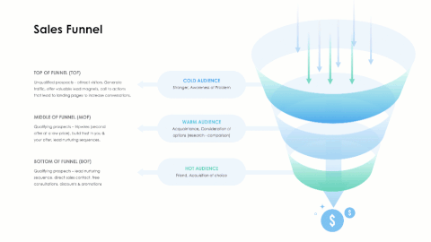
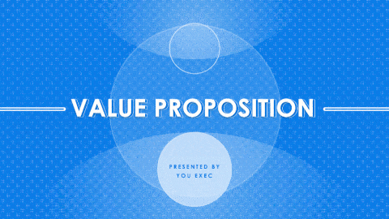
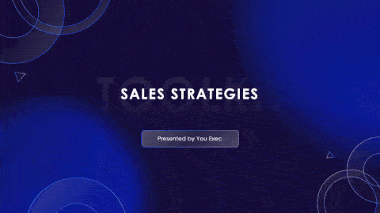

Related resources:
The following resources are related to this framework and can save you hours of work.
If you’re a free or paid member, log into You Exec first for a faster download experience.
Sales Funnel
Value Proposition
Sales Strategies Toolkit
Design-Thinking Toolbox

